Slide 1

What is Swift?
compiled programming language created by Apple
created for developing iOS, OS X, watchOS, and more

Slide 2
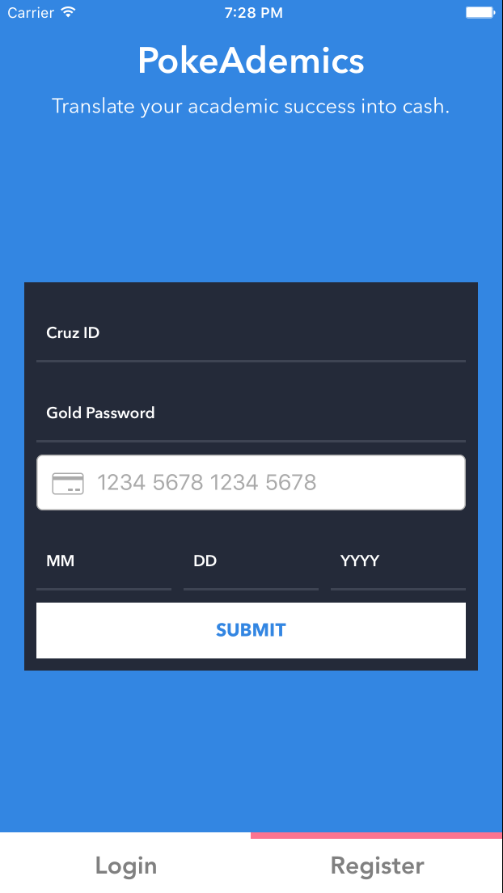
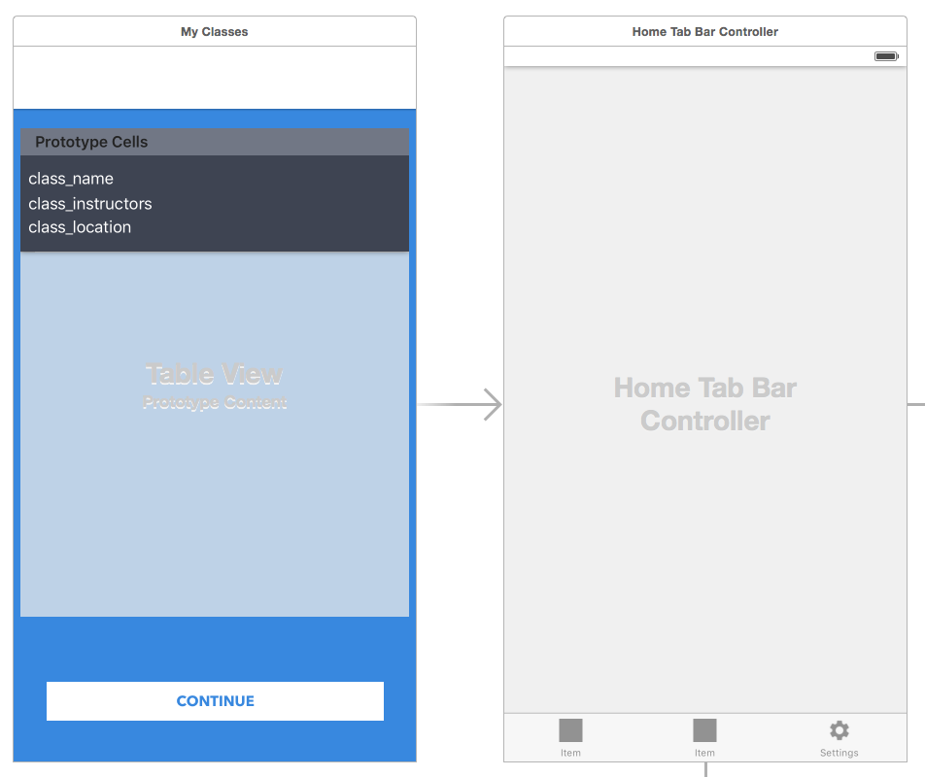
How does it work?
Storyboard shows Views
Views show each individual screen of the app

Slide 3
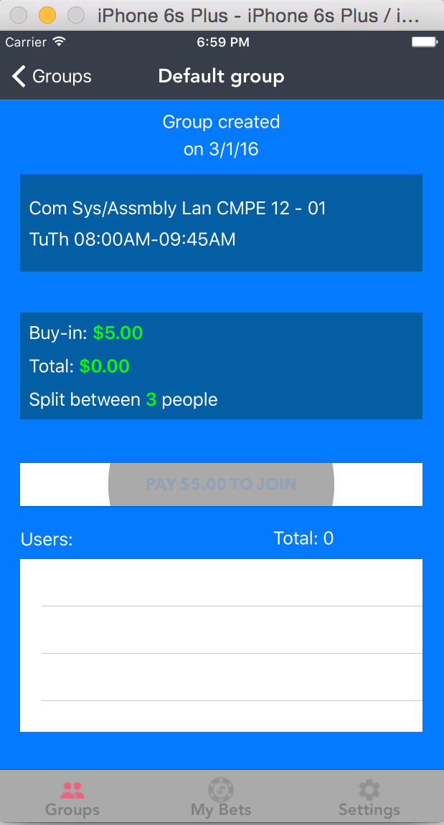
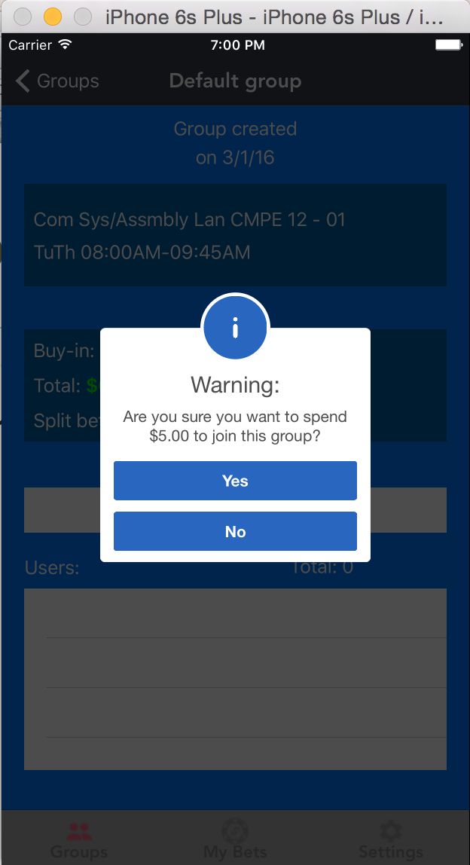
Pulling online Libraries
import user-made GitHub extensions to fully customize UI elements
Alert pop-up
screen
Button ripple animation on click

Slide 4
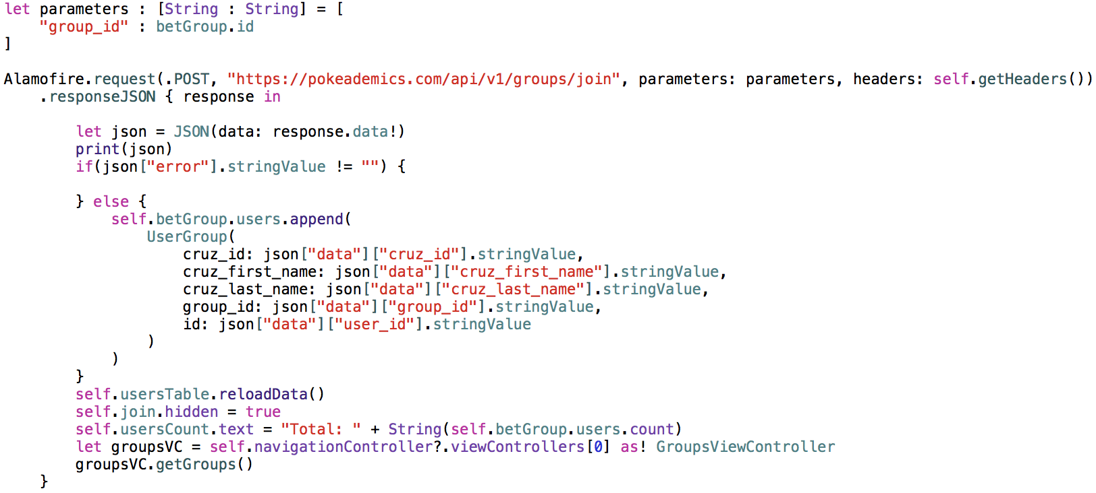
Parsing JSON in Swift
receive JSON data from server, convert it into information that we can use in our Views

